Slide 1
MILESTONE-2 Title & Team Introduction:
Project Title: AI-Powered-Enhanced EHR Imaging & Documentation System
Team: Team A
Members: Samriddhi Tiwary, Hima Anjuri, Pravalika, Rajeswari, Dhanasree, Sushmasri, Shazfa, Shobith Reddy, Gokula Prasath
Course/Semester/Instructor: Aryan Khurana
Date: 15/09/2025

Slide 2
Problem Statement
Medical images (MRI, CT, X-ray) often contain noise or low resolution, making diagnosis difficult.
The project aims to enhance medical images using AI techniques for clearer visualization and improved diagnostic support.

Slide 3
Objectives
- Apply Generative AI for denoising and reconstruction of medical images.
- Improve resolution and clarity for clinical visualization.
- Train and validate enhancement models using open-source libraries and AI tools.

Slide 4
Proposed Solution / Approach
- Use classical super-resolution & denoising models (DnCNN, EDSR, SRCNN).
- Explore Generative AI-based image enhancement using AI APIs (OpenAI/Gemini).
- Compare results using visual inspection and quantitative metrics (PSNR, SSIM).

Slide 5
Implementation Details
- Dataset: MRI, CT, X-ray images (~20–50 samples).
- Preprocessing: Conversion to .png (256x256), normalization, train-test split.
- Tools: OpenCV, PIL, TensorFlow, PyTorch, Matplotlib.
- Workflow: Preprocessing → Model Training → Image Enhancement → Validation.
- Outputs: Side-by-side input vs. enhanced images saved for evaluation.

Slide 6
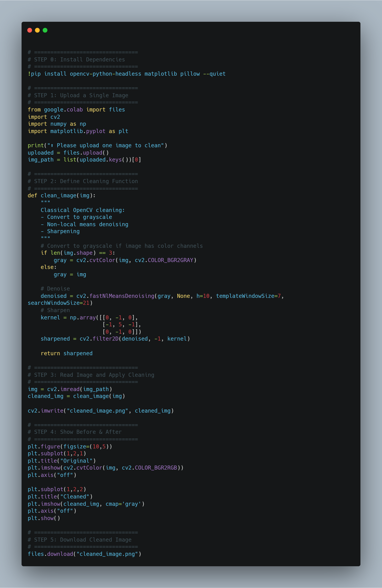

Slide 7
Results & Observations
- Enhanced images showed improved clarity, reduced noise, and better sharpness.
- Visual inspection confirmed diagnostic improvements.
- PSNR/SSIM metrics showed modest gains, not always reflecting true quality.
- Generative AI and OpenCV gave more practical results than deep learning models on limited resources.

Slide 8
Challenges & Learnings
- Difficulty handling unstructured datasets (different formats/sizes).
- High computational cost for deep learning models on CPU/Colab.
- Metrics (PSNR/SSIM) not always aligned with visual improvements.
- Maintaining proper data, model, and output organization was crucial.
- Learned the tradeoff between classical methods (reliable) vs. GenAI (innovative).

Slide 9
Conclusion & Next Steps
Conclusion:
- Implemented multiple approaches (DnCNN, EDSR,SRCNN, OpenCV, Generative AI) for enhancement.
- Deep learning models were limited by compute resources but GenAI/OpenCV were effective.
Next Steps:
- Automate preprocessing → enhancement → validation pipeline.
- Train on larger, more diverse datasets.
- Explore hybrid models combining classical + generative AI.
- Incorporate clinician feedback for clinically relevant improvements.

